Slide 1
NETWORK TOPOLOGIES
Subject: ICT
Student Name: Ezza Masood
Roll number: 2502640

Slide 2
TABLE OF CONTENT
INTRODUCTION TO NETWORK TOPOLOGIES.
BUS TOPOLOGIES.
STAR TOPOLOGIES.
RING AND MASH TOPOLOGIES.
CONCLUSION.

Slide 3
INTRODUCTION TO NETWORK TOPOLOGIES
DEFINITION:
Network topology is the layout or structure of a computer network. It show how computer and devices are connected.
IMPORTANCE:
Help in better network performance. Makes troubleshooting easier. Improves communication efficiency.
TYPES:
Bus topology
Star topology
Ring topology
Mesh Toplogy

Slide 4
BUS TOPOLOGY:
DESCRIPTION:
All computer are connected to a single main cable called a bus.
Data travels in both direction on the bus.
ADVANTAGES:
Easy to install.
Low cost.
Requries less cables.
DISADVANTAGES:
If main cables fails, whole network stops
Slow when many devices are connected.
Difficult to troubleshoot.

Slide 5
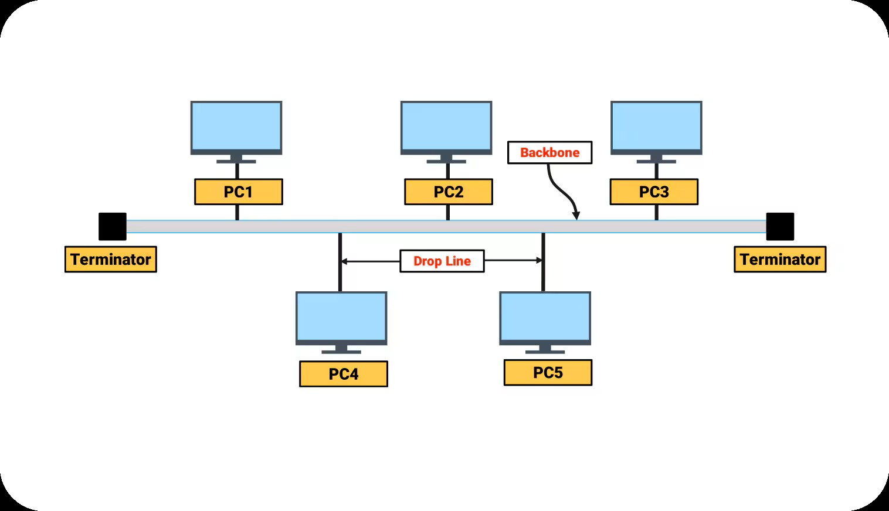
EXAMPLE:
Small office or classroom network

Slide 6
STAR TOPOLOGIES:
DESCRIPTION:
All computer are connected to a central device called hub or switch.
Data passes through the central device.
ADVANTAGES:
Easy to manage.
Fast data transfer.
Failure of one computer does not effect others.
DISADVANTAGES:
Central devices failures stops whole network.
More cables required.
Higher cost than bus topology.

Slide 7
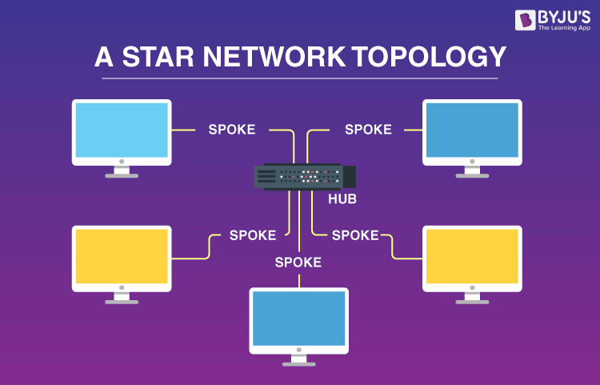
EXAMPLE:
Home and offices networks.

Slide 8
RING TOPOLOGY:
DESCRIPTION:
Devices are connected in a circular form.
Data moves in one direction
ADVANTAGES:
Equal access for all devices.
Good performance under heavy load.
DISADVANTAGES:
Failures of one device affects whole network.
Difficult to reconfigure.

Slide 9
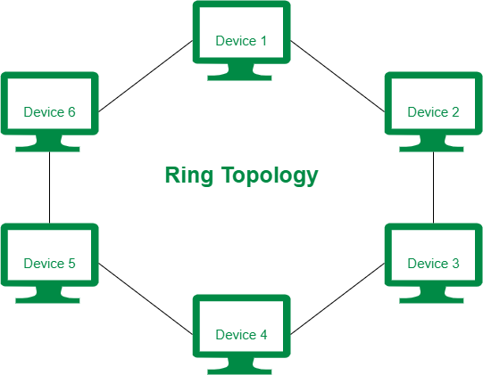
EXAMPLE:

Slide 10
MESH TOPLOGY:
DESCRIPTION:
Every devices is connected to every other devices. Each connection has its own dedicated communication path,so data can travel in multiple way.
ADVANTAGES:
It is very reliable.
It consist of high security.
It allow multiple paths to run smooth data flow.
DISADVANTAGES:
It is very expensive requires a lot of cables.
It has difficult maintenance managing many connection is hard
Setup and configuration are difficult.

Slide 11
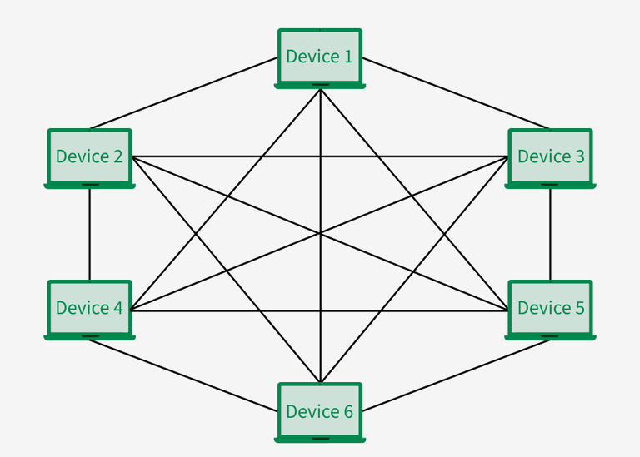
EXAMPLE: wireless mesh network in cities.

Slide 12
THANK YOU!

